Slide 1

Year 4 Parent Meeting

Slide 2
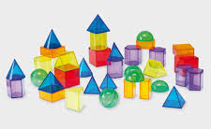
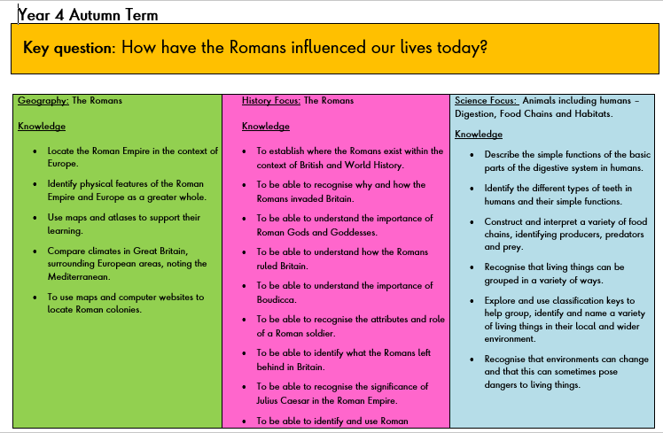
Autumn term: How have the Romans influenced our lives today?
Spring term: Who were the Anglo-Saxons and Vikings and why did they invade and settle in Britain?
Summer term: What were the achievements of the Ancient Egyptians and why was the River Nile so significant?

Slide 3
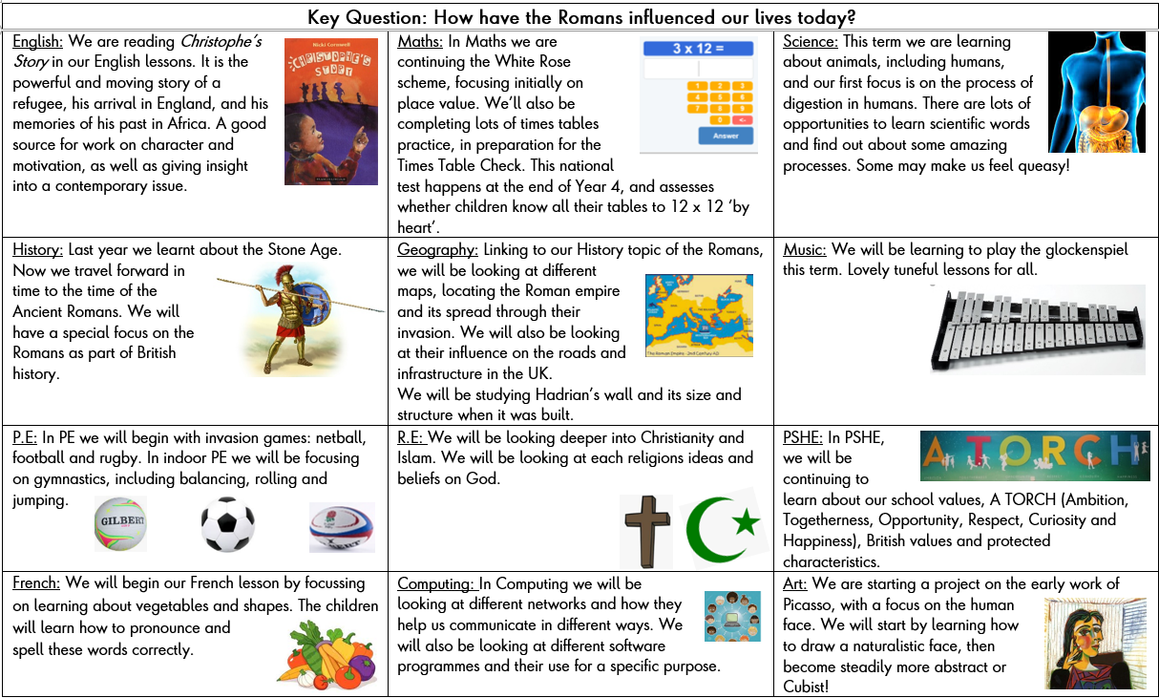
Curriculum Newsletter

Slide 4
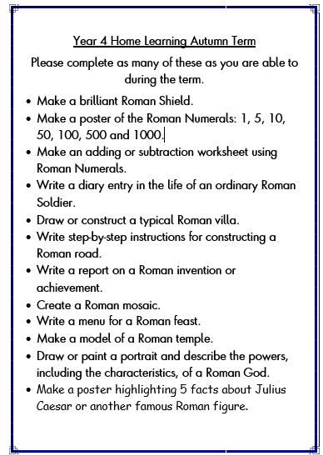
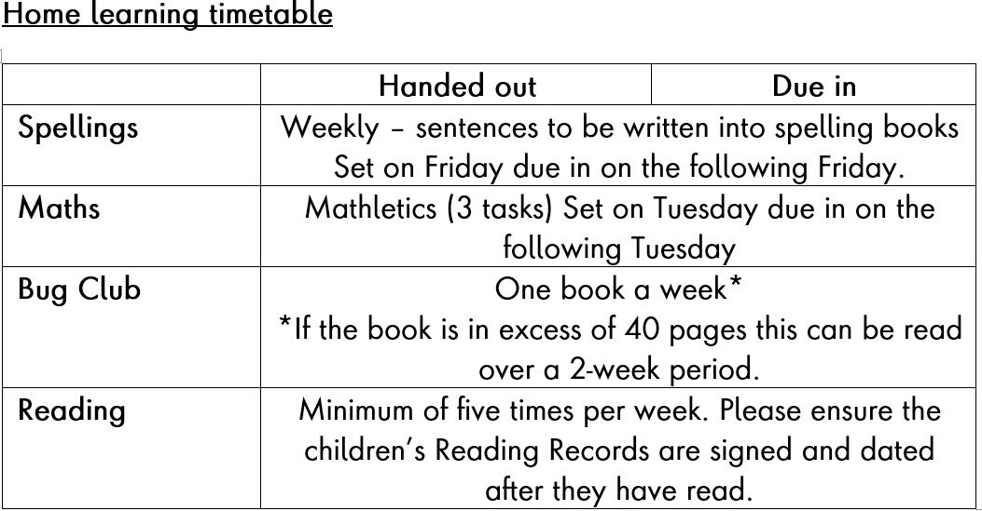
Home Learning Timetable
In addition, please endeavour to read with your child as frequently as possible and record this in their Reading Record. Also, please encourage them to undertake the practical home learning tasks posted on the school website.

Slide 5
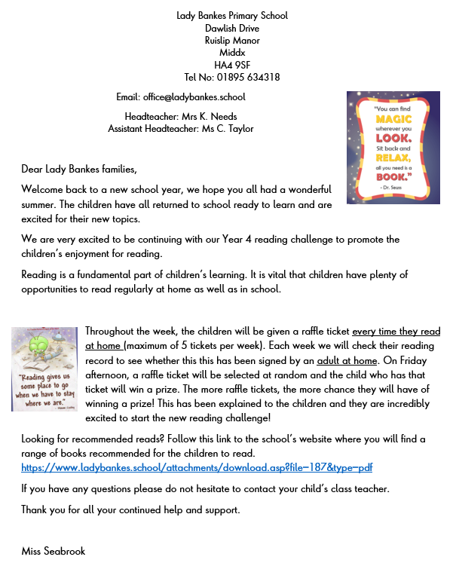
Year 4 reading challenge
-Sign your child’s reading record when they read at home.
Children receive a raffle ticket for a signed entry.
Raffle tickets will be drawn every Friday.
Winning ticket will receive a prize.
This will be repeated every week.

Slide 6


Assessment:
3 assessment points (formal testing)
Mathematics, Reading Comprehension, SPAG
Other subjects teacher assessed
Reading:
Heard weekly – more often for some children
Little Wandle (Phonics): support groups for some children

Slide 7
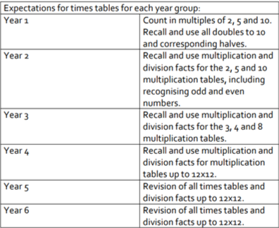
MTC – Multiplication Times Tables Check
The purpose of the MTC is to see whether children in Year 4 can fluently recall their multiplication tables. The Year 4 Programme of Study states:
‘Pupils should be taught to recall multiplication and division facts for multiplication tables up to 12 × 12’.
It will be an on-line, on-screen assessment which will take less than 5 minutes to complete. It will be automatically scored and results will be available to schools.
The national curriculum specifies that pupils should be taught to recall multiplication and division facts for
multiplication tables up to 12 × 12 by the end of Year 4.

Slide 8
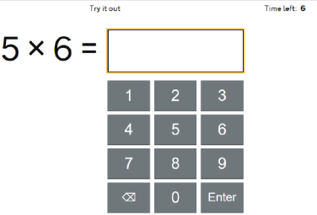
MTC – Multiplication Times Tables Check
Timer
Answer box
Top Tip: We encourage the children not to press enter!

Slide 9
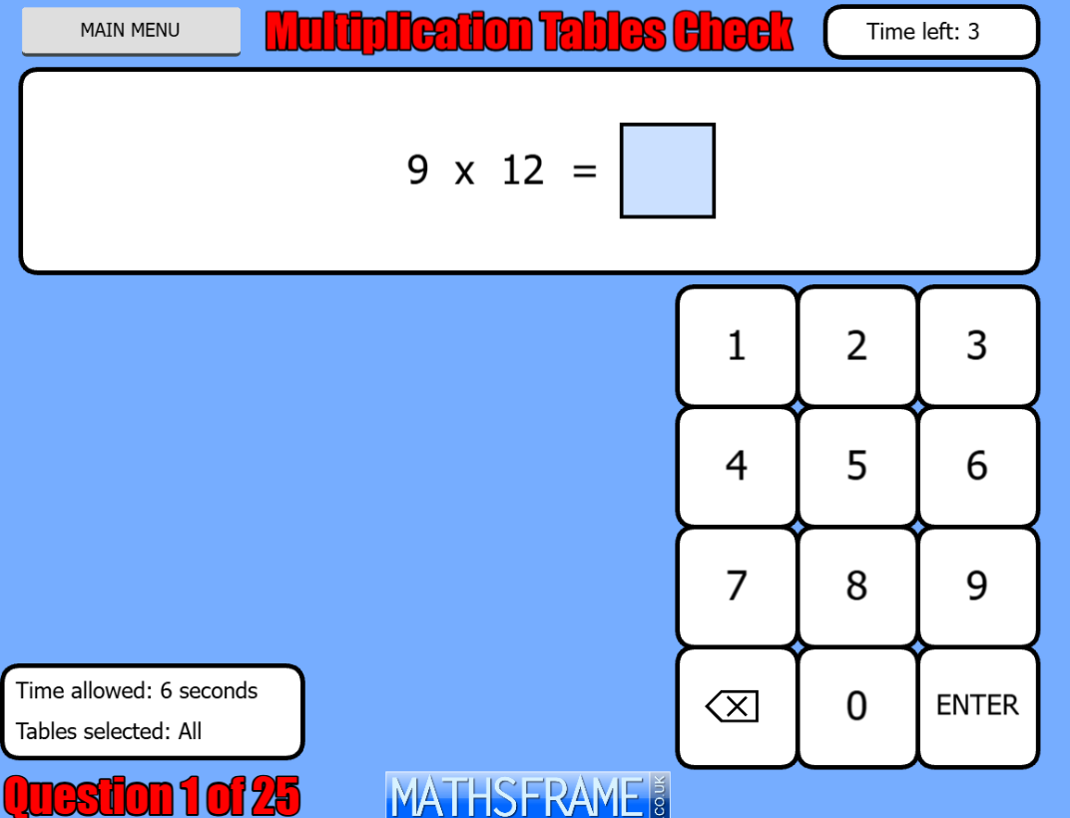
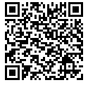
MTC – Multiplication Times Tables Check
https://mathsframe.co.uk/en/resources/resource/477/Multiplication-Tables-Check

Slide 10
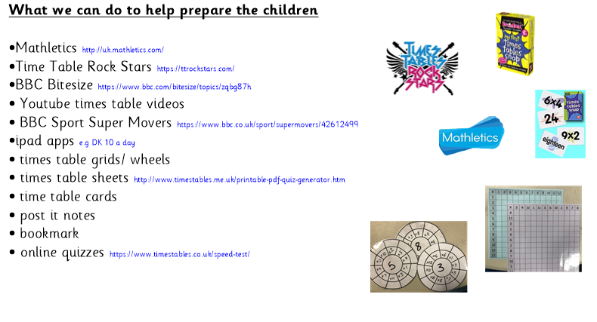
topmarks.co.uk/maths-games/hit-the-button

Slide 11


Game modes
Single Player:
  Jamming
  Garage
  Sound Check
Multiplayer
  Festival
  Arena
Avatar!!
https://ttrockstars.com/

Slide 12
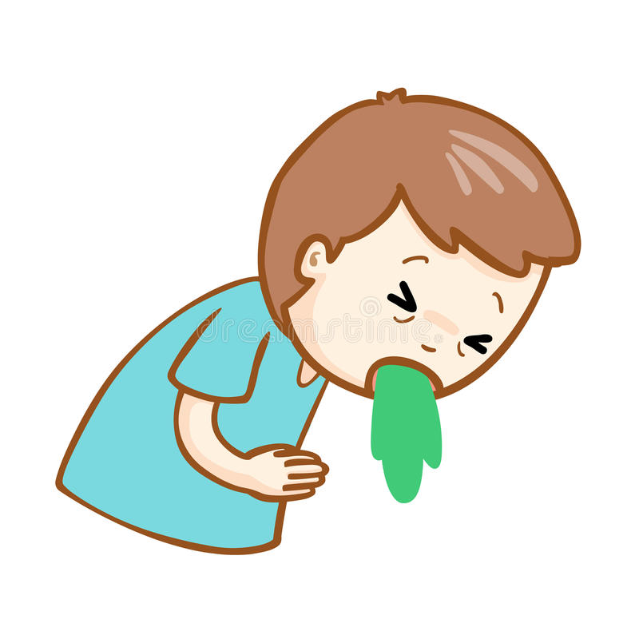
Be creative……….
I ate and ate until I was sick on the floor.
8 x 8 = 64

Slide 13
Trips
Autumn Term
Verulamium (St Albans) – The museum of everyday life in Roman Britain. The children will take part in an Artefact workshop, visit the Museum’s gallery and visit the Hypocaust and/or Roman wall remains in Park.
Cineworld – South Ruislip
Into Film Festival
Other trips TBC

Slide 14
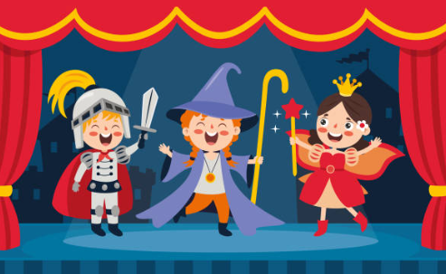
Class Assembly
The dates for these will be on the newsletter, remember to add these to your diary!

Slide 15
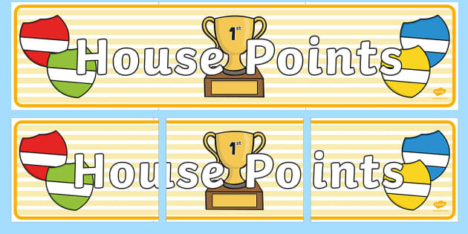
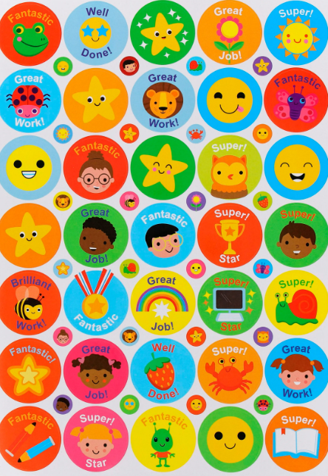
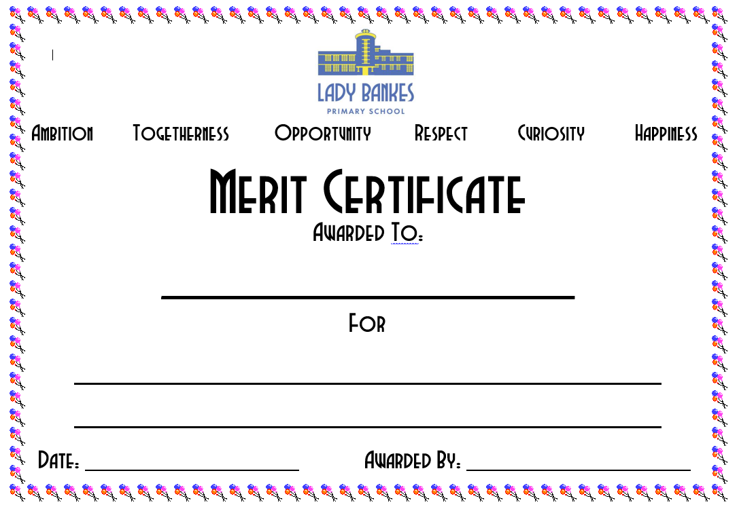


Rewards

Slide 16
Thank you
Please get in contact
Email us at: office@ladybankes.school
Or call reception to arrange an appointment
Or speak to us afterschool

