Slide 1

Year 1
Parents Information session
15th September 2026

Slide 2
Reminder of the Year 1 Team
1DA – Mrs Abbott and Mrs Widdows
1US – Mrs Sathyarooban and Mrs Jones
1CL – Mr Clarke, Mrs Lock and Miss Geary
Mrs Donaghey - Assistant Headteacher for KS1
- Wednesdays in 1DA

Slide 3
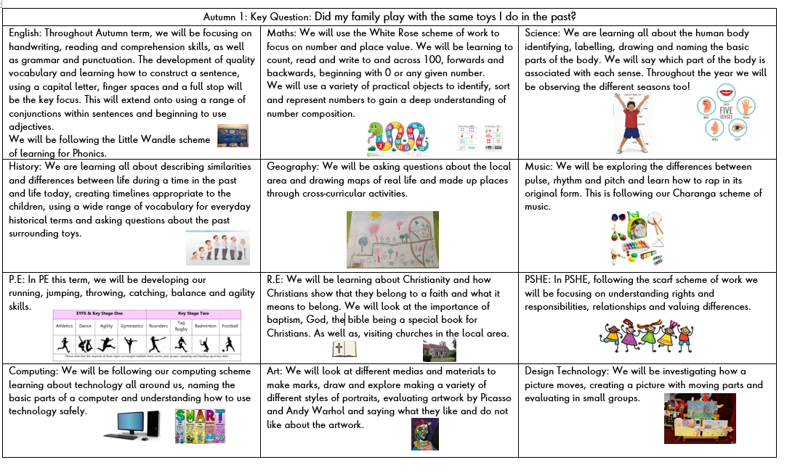
Autumn Term 1
This is available on the school website and will be updated every term.

Slide 4
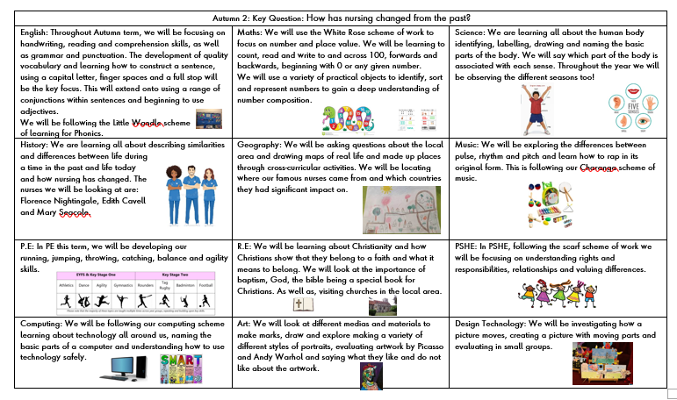
Autumn Term 2
This is available on the school website and will be updated every term.

Slide 5
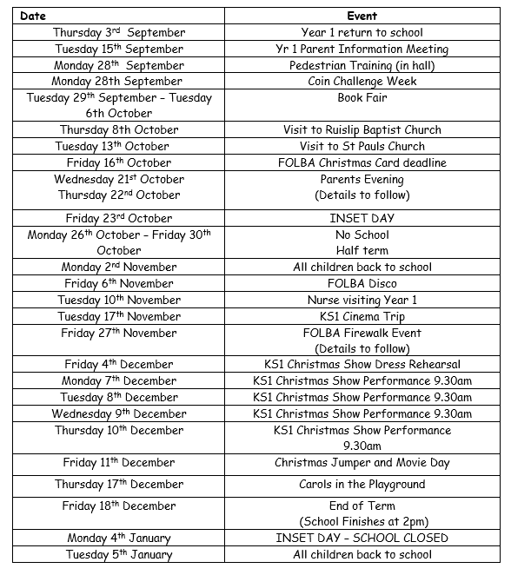
Dates to remember
If you would like to volunteer to help us walk to St Paul’s Church or Ruislip Baptist Church, please let your child’s teacher know.
The only additional date from the newsletter that went out last week is the cinema trip date.

Slide 6

New DFE Guidance for Early Reading and Phonics
The journey to independent reading and writing begins with Phonics
littlewandlelettersandsounds.org.uk
Why Little Wandle?
Excellent training for all staff to ensure consistency.
Every aspect of phonics and reading included in a detailed, thorough and systematic approach.
Engaging resources without distracting from the learning.
Comprehensive system for identifying and supporting children requiring extra help and useful support
for parents.
Notes:
Government changes mean a change (for the better) in how we teach phonics and reading at school - make sure there is consistency throughout
Early reading is the stage where children are learning to become fluent readers through the use of phonics

Slide 7
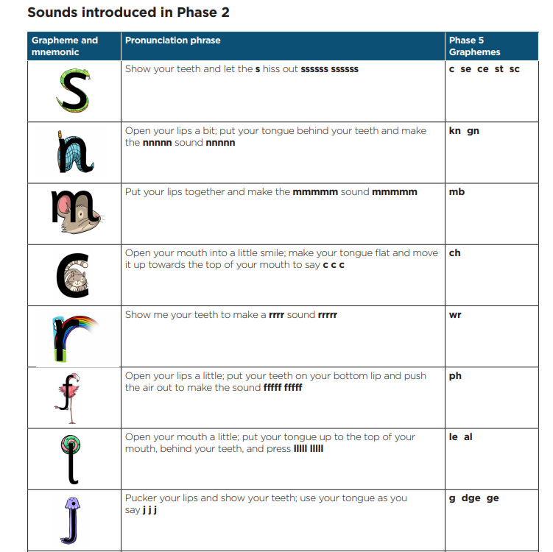
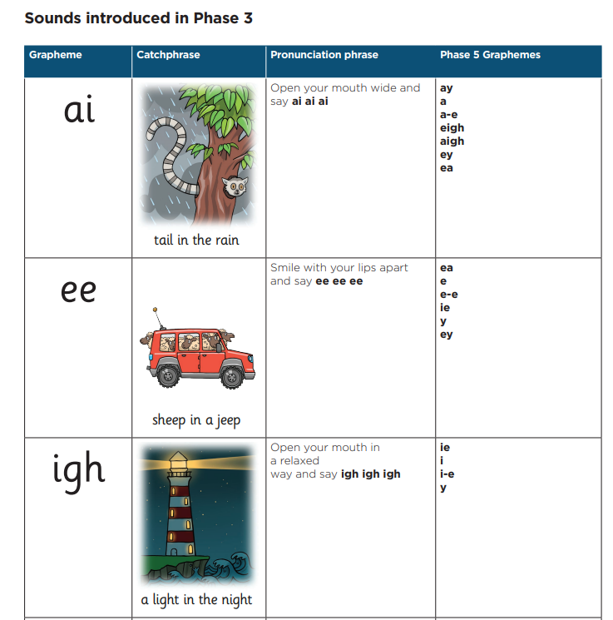
How we Teach Phonics?
At Phase 5, children learn alternative graphemes for sounds introduced in Phases 2 and 3.
Specific order of teaching
Daily short lessons
Correct pronunciation is vital - Videos on LW
Revisit previously
taught sounds at
start of each lesson

Slide 8
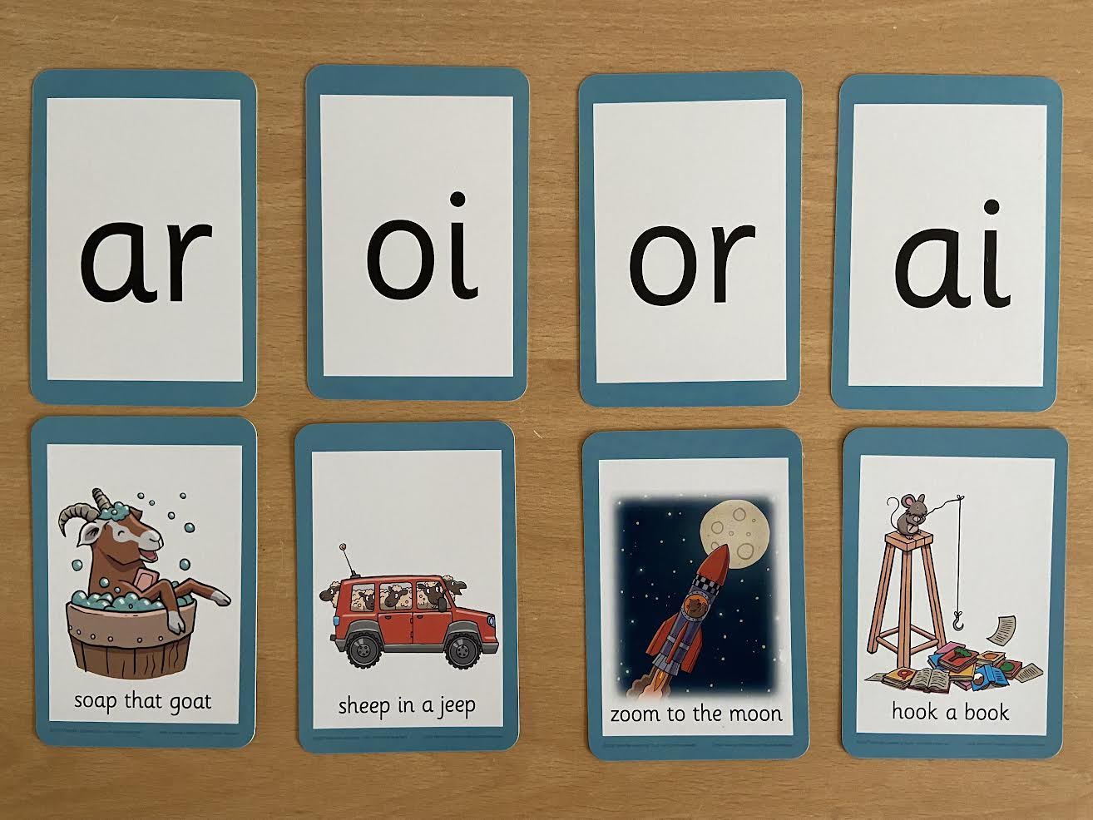
Notes:
Vowel digraphs taught with a short caption to help children remember
Also trigraphs igh, air

Slide 9

Notes:
Words that do not follow the rules and cannot be decoded – tricky words/ exception words
Chn are taught what part of the word is tricky

Slide 10
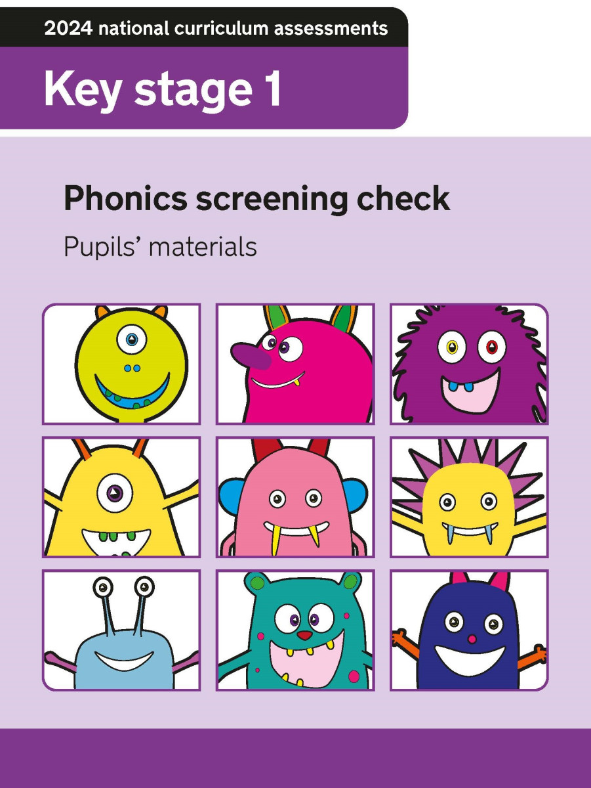
Phonics Screening Check
The phonics screening check is an informal test that children will need to complete at the end of Year 1. During the test, which is designed to test their ability to decode words using their phonics knowledge, children will be required to read a mixture of 40 real and nonsense words.
The phonics screening check is an important part of children’s early phonics education. While it isn’t conducted under normal test conditions and won’t determine whether or not they progress into Year 2, it’s a crucial assessment as it shows how well their reading and phonics skills are developing.
The purpose of the phonics screening check will be to confirm that all children have learned phonic decoding to an age-appropriate standard.
Children who have not reached this level should receive extra support from their school to ensure they can improve their decoding skills, and will then have the opportunity to retake the phonics screening check.

Slide 11
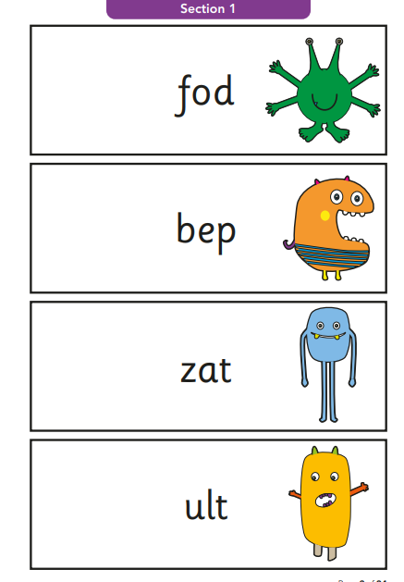
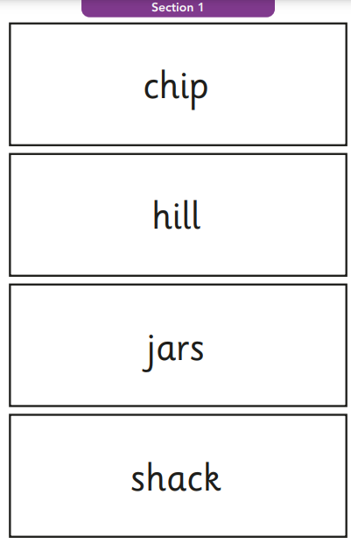
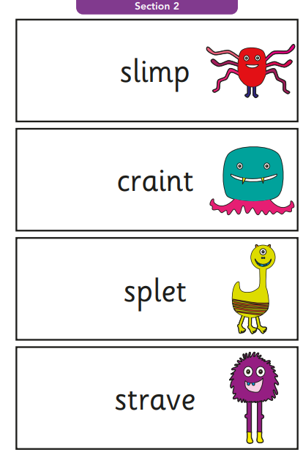
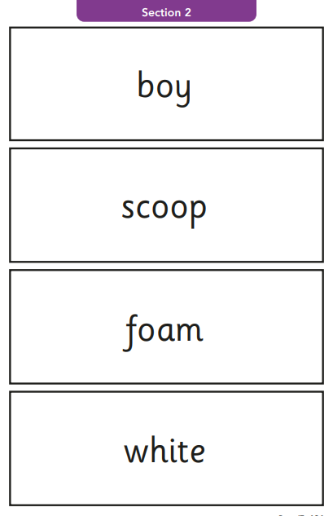

Slide 12

Reading
We want children to
love reading
Learning to read should be
a positive experience
Reading should be
enjoyable
We want children to read
for pleasure
Reading underpins children’s access to the curriculum
and clearly impacts on their achievement
Notes:
We all know how important learning to read is and the impact it has on a childs success - it has to be a positive experience
Whats the reality? Reluctant to read because they find it hard
Frustration stress tears – that’s just the parents
Important to look at the big long term picture

Slide 13

How we teach reading?
Reading practice sessions are :
Books are :
matched to children’s
secure phonic knowledge
and word reading
Timetabled 3 times a week
Taught by trained teacher or
teaching assistant
read three times
Taught in small groups
sent home
Notes:
Quite a big difference to how reading was previously taught

Slide 14

Reading Practice Books carefully matched so children can read
fluently and independently
3 Reads – each one begins with some quick sounds and words practice
Decoding
Prosody
(intonation, expression)
3. Comprehension
When children take their book home to read they should be 95% fluent
Please do not worry that a book is too easy – your child needs to develop
fluency and confidence in reading. Re-reading a book they have had before
helps develop fluency – this is the goal.
Children will bring home one Little Wandle phonic book each week. This will be the same book they have read
in their three reading sessions that week in school. This book will come home on a Friday and must be returned
to school the following Tuesday.

Slide 15
Supporting your child with reading
Although your child will be taught to read at school, you can have a huge impact on their reading journey by continuing their practice at home.
There are two types of reading book that your child may bring home:
A reading practice book. This will be at the correct phonic stage for your child. They should be able to read this fluently and independently.
A sharing book. Your child will not be able to read this on their own. This book is for you both to read and enjoy together.

Slide 16
PE
Class | Days
1DA | Monday and Friday
1US | Monday and Wednesday
1CL | Monday and Friday
Children should have the following:
  A colour house top with the school logo
  A black zip jacket with the school logo
  Black shorts
  Black tracksuit bottoms
  Trainers
  Plimsolls
Children are expected to have their named PE kits in for PE days. Class teachers will
send the PE kits home at the end of each half term/holiday. These should be
washed and returned after the break.

Slide 17
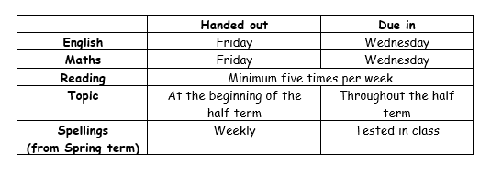
Home Learning Schedule
Home learning should be used weekly to consolidate Reading and Mental Arithmetic skills.

Slide 18
Intervention Support
We are in the process of setting up intervention groups for the following areas; handwriting, foundational Maths skills and Phonics.
We will add and amend these interventions as the year progresses in order to keep on track as much as possible.
All children are heard read by an adult at least 3 times a week in their classroom. Less advanced Readers (20% of Year Group) are being heard more than three times a week by an adult in their classroom.

Slide 19

Upcoming Trips and Info
Please see below various trips, visitors and virtual events in school this year:
St Paul’s Church
Ruislip Baptist Church
Nurse visit to school
Pedestrian Training
Ruislip Lido
Legoland
Windsor Castle
Medieval Assembly
We will be setting up a link on your Parent Pay whereby you will be able to add money into the account for trips later on in the year.
Please keep an eye on our half termly Year group Newsletters (these will always be handed to your children as a paper copy) as well as the general newsletters, curriculum newsletters, weekly GC updates/ homework.

Slide 20

If you have any questions then please do not hesitate to contact the Year One team.

