Slide 1

Year 3

Slide 2
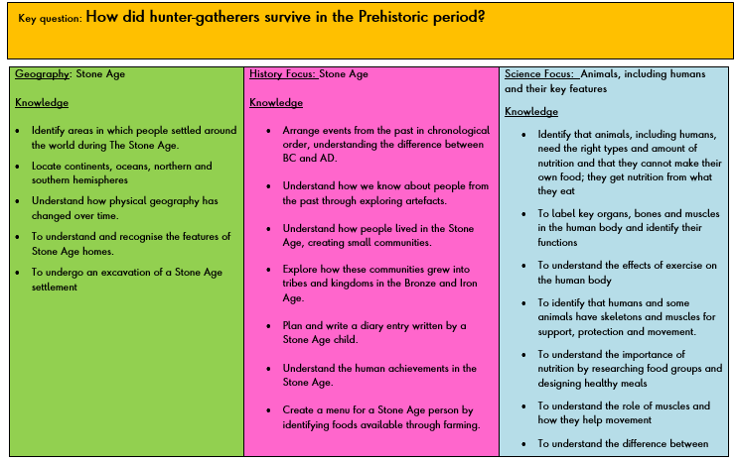
Autumn term: How did hunter-gatherers survive in the Prehistoric period?
Spring term: Why is the Kingdom of Benin so significant?
Summer term: Why is Ruislip such a desirable place to live?

Slide 3
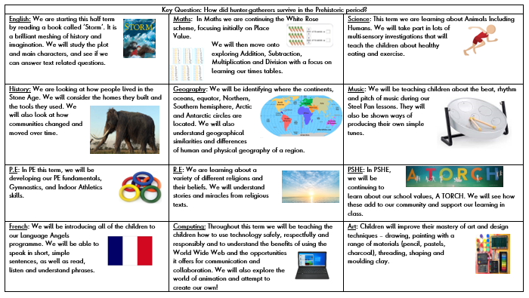
Curriculum Newsletter

Slide 4
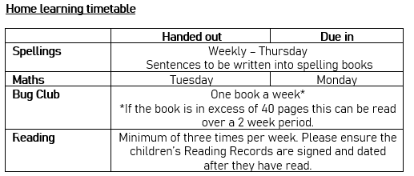
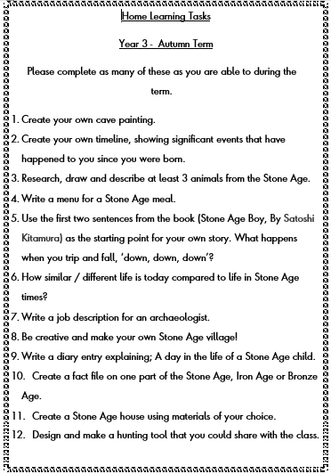
Home Learning Timetable
In addition, please endeavour to read with your child as frequently as possible and record this in their reading Record. Also, please encourage them to undertake the practical home learning tasks posted on the school website.

Slide 5


Assessment
Each term we formally assess the children in Mathematics, Reading Comprehension and SPAG
Other subjects teacher assessed
Reading
Heard weekly – more often for some children
Little Wandle (Phonics)
Revisit through our spelling patterns
Support groups for some children

Slide 6

Mathletics
One of our Maths home learning platforms is Mathletics, every Tuesday the children will be assigned a task/tasks linked to the objectives being covered in their Maths lessons. The children’s log in details are at the back of their reading records.

Slide 7
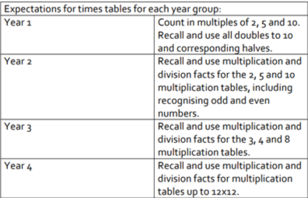
Times Tables
The national curriculum specifies that pupils should be taught to recall multiplication and division facts for
multiplication tables up to 12 × 12 by the end of Year 4.
How can you help your child?

Slide 8

Who would like to have a go?

Slide 9
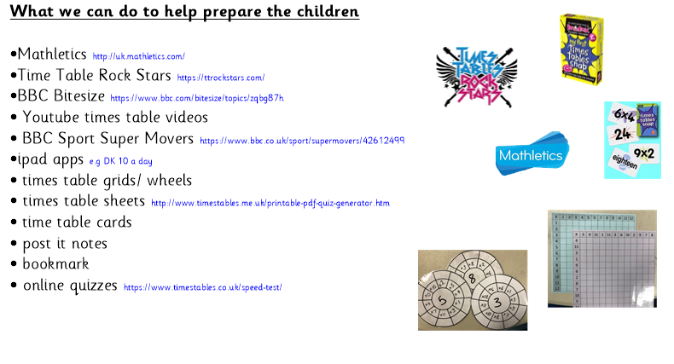
topmarks.co.uk/maths-games/hit-the-button

Slide 10


Game modes
Single Player:
  Jamming
  Garage
  Sound Check
Multiplayer
  Festival
  Arena
Avatar!!
https://ttrockstars.com/

Slide 11
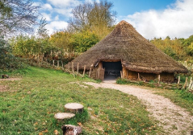
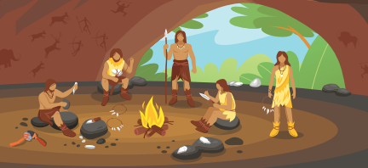

Trips and visits
Chiltern Open Air Museum - 16th October
A day in the Stone Age Life is set in the ‘middle’ Stone Age period known as the Mesolithic. The children focus on hunting and gathering skills, shelter building, and tool making; use of pigments, cordage and making fire. Guided by costumed educators they will learn much about using the environment to sustain life.
Into Film Festival – 27th November

Slide 12
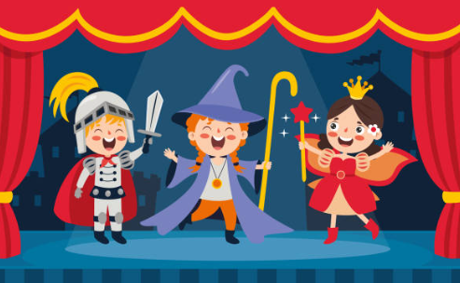
Class Assembly

Slide 13

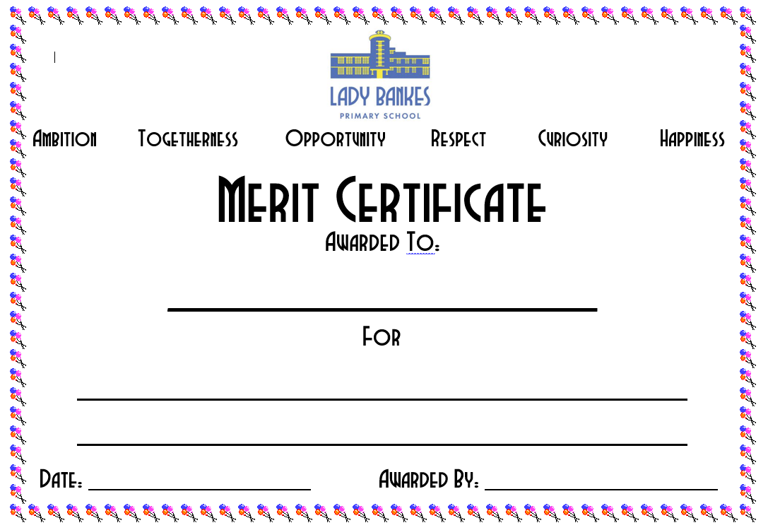
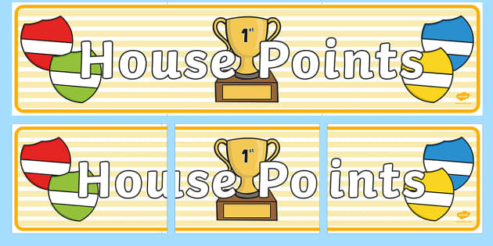

Rewards

Slide 14
Thank you
Please get in contact
Email us at: year3@ladybankes.school
Or call reception to arrange an appointment
Or speak to us afterschool

