Slide 1

Lady Bankes Primary School
Welcome to
Our aim is to provide a rich, varied, and inclusive curriculum which harnesses every child’s potential.

Slide 2
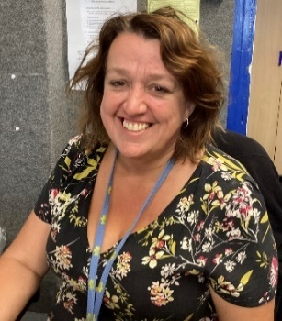
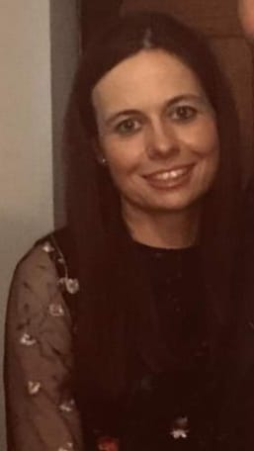
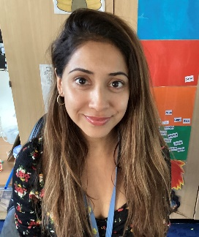
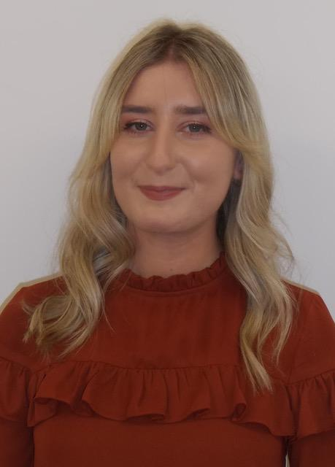
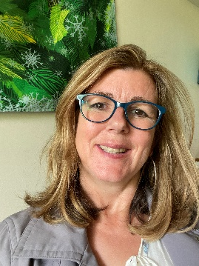
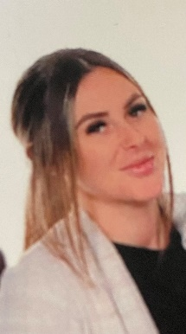
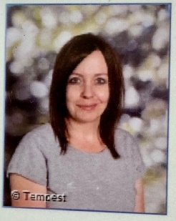
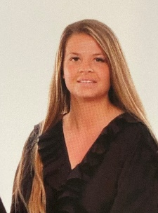
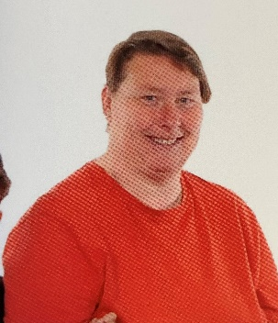
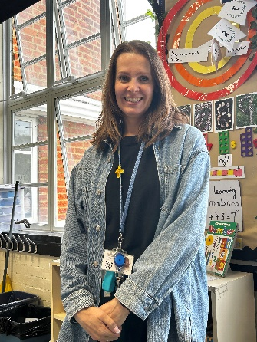
Meet the Team
Mrs McCarthy
Assistant Head of Early Years
Miss Pearce
Year Group Lead
RDP
Mrs O’Sullivan
Mrs Roy
Miss Hawkins
ROR
RLH
Miss Hanson
Miss Reid
Mrs Bryan
Miss Hone
Miss Wright

Slide 3
What happens in September…
Indoors and outdoors classroom
Teaching sessions daily in own class
Outdoor classroom is shared by 3 classes
Continuous provision throughout environment
RDP
RLH
ROR
Our aim is to provide a rich, varied, and inclusive curriculum which harnesses every child’s potential.

Slide 4
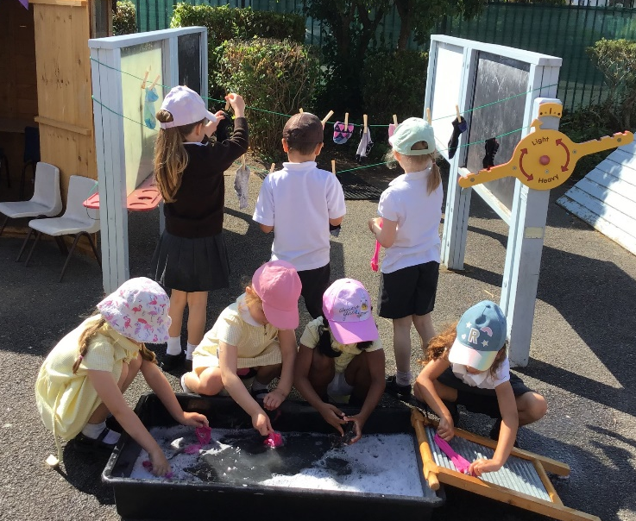
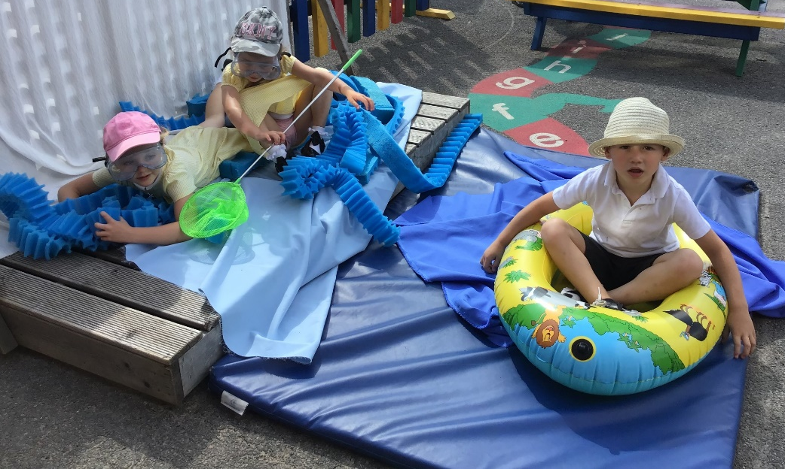
Children learn as they play. Most importantly, in play children learn how to learn.
Fred Donaldson
Our aim is to provide a rich, varied, and inclusive curriculum which harnesses every child’s potential.

Slide 5
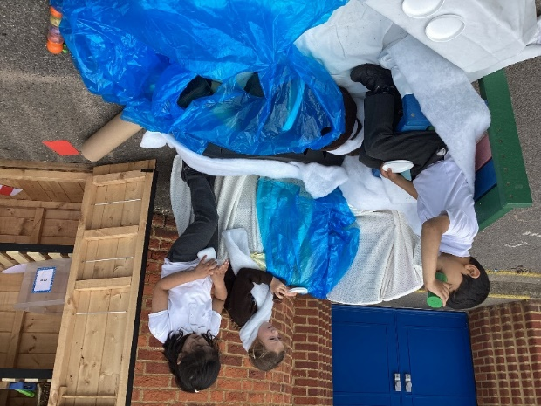
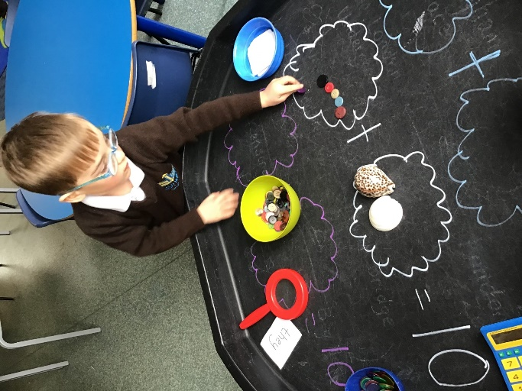
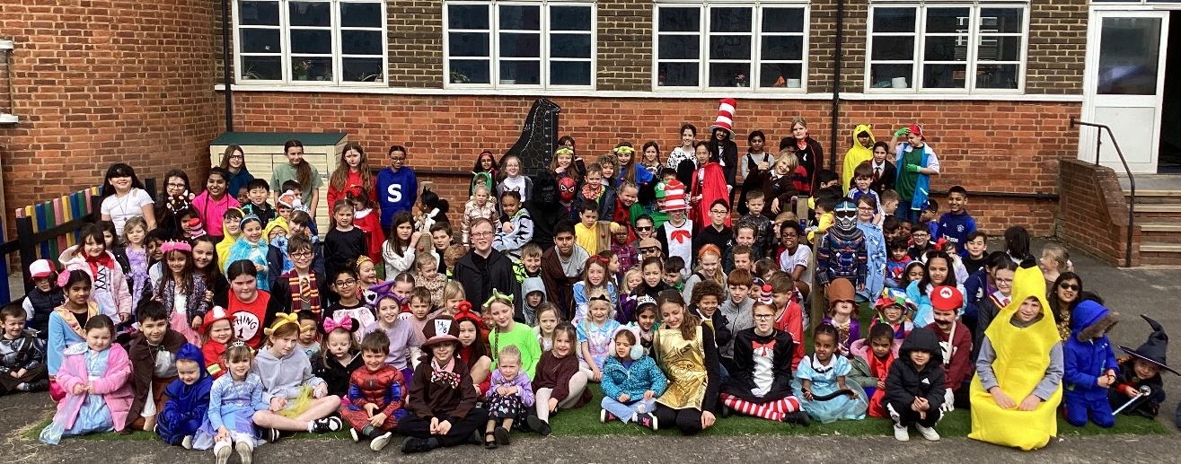
Aim
to provide a rich, varied, and inclusive curriculum which harnesses every child’s potential.
Our aim is to provide a rich, varied, and inclusive curriculum which harnesses every child’s potential.

Slide 6

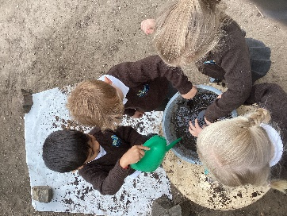
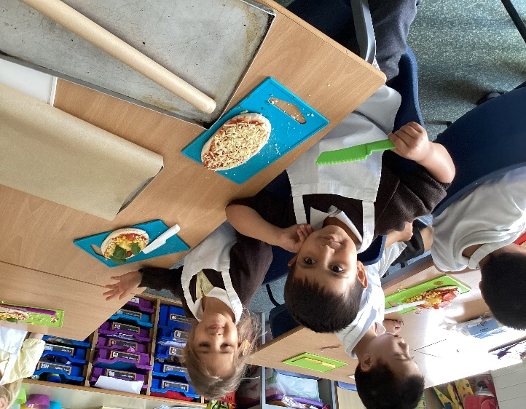
Vision
Ambition
Togetherness
Opportunity
Respect
Curiosity
Happiness
Our aim is to provide a rich, varied, and inclusive curriculum which harnesses every child’s potential.

Slide 7
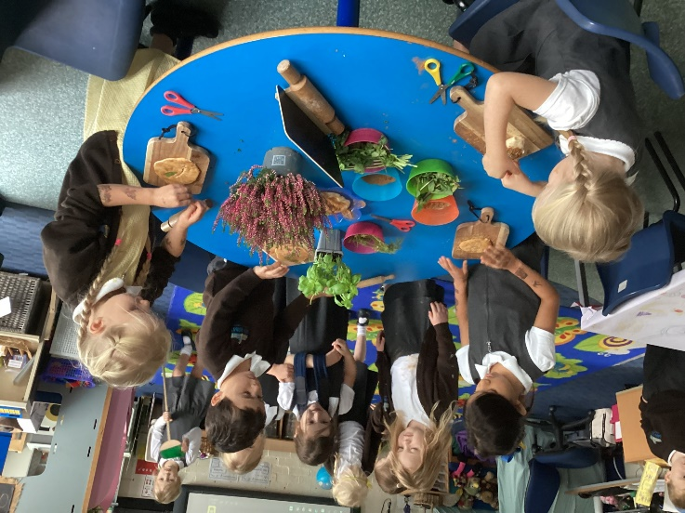
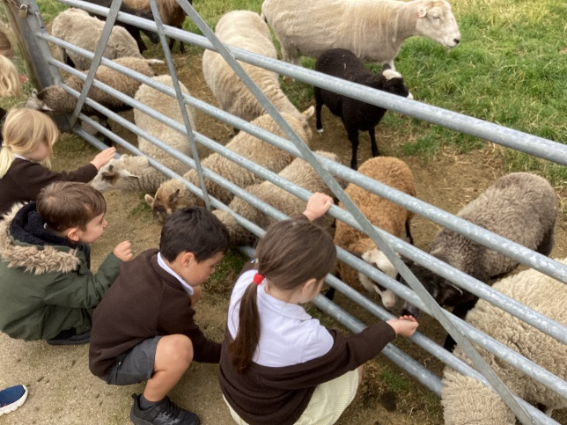
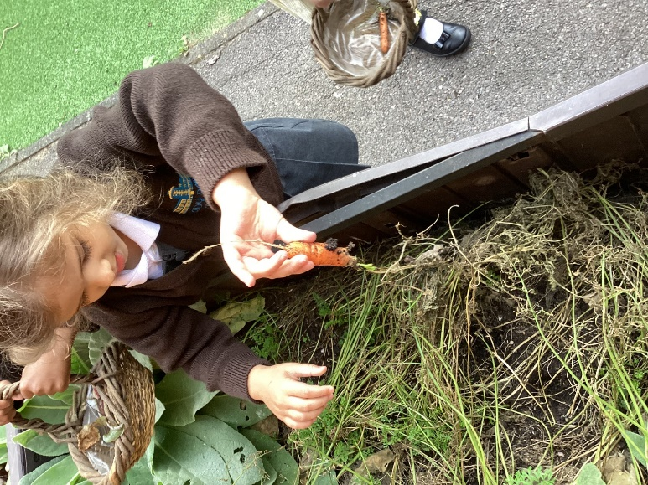
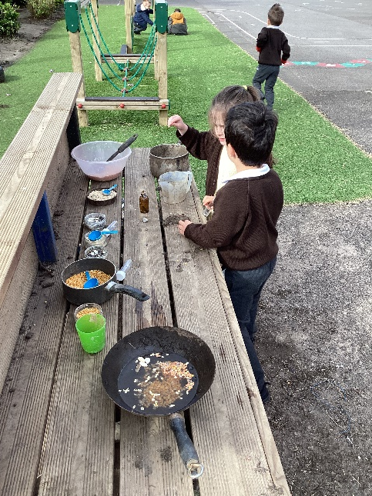
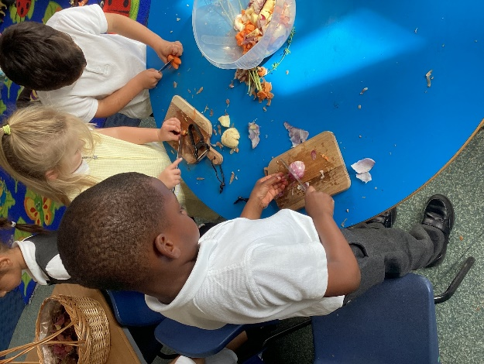
Enriched Learning
Our aim is to provide a rich, varied, and inclusive curriculum which harnesses every child’s potential.

Slide 8
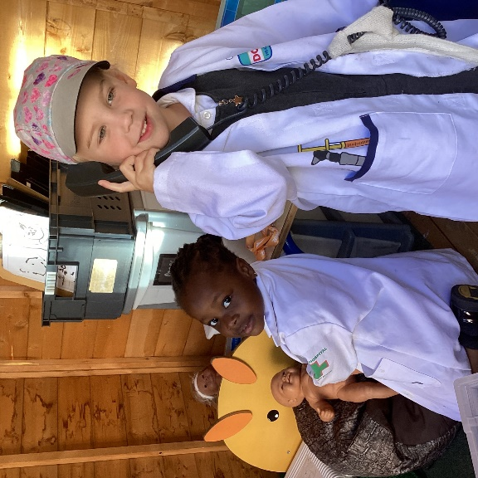
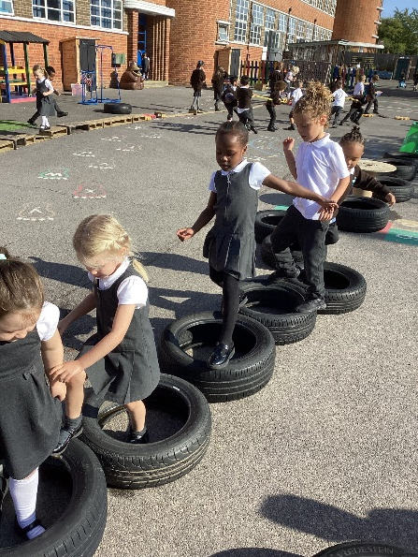
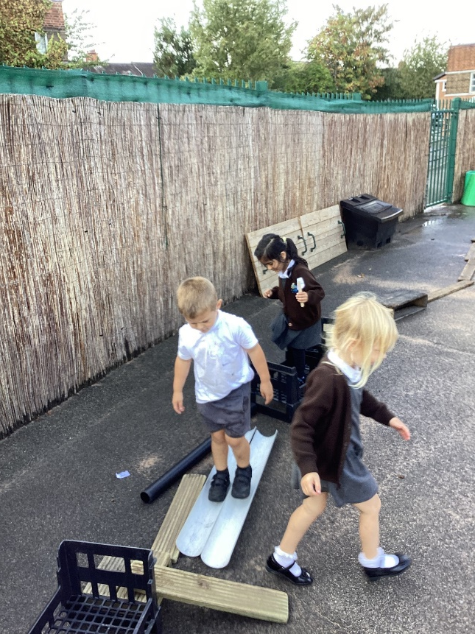
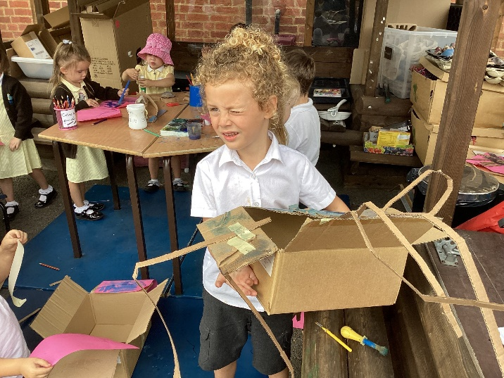
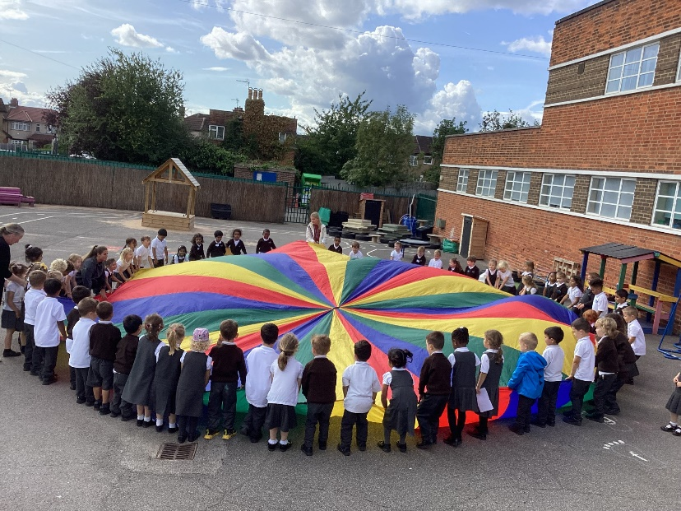
Out and about
Our aim is to provide a rich, varied, and inclusive curriculum which harnesses every child’s potential.

Slide 9
Essential Items
All items clearly labelled
School Uniform (black school shoes)
Spare change of clothes (including socks)
Lady Bankes book bag
Reusable water bottle
Sun hat in summer and winter wear for winter
Welly boots (clearly named)
Our aim is to provide a rich, varied, and inclusive curriculum which harnesses every child’s potential.

Slide 10
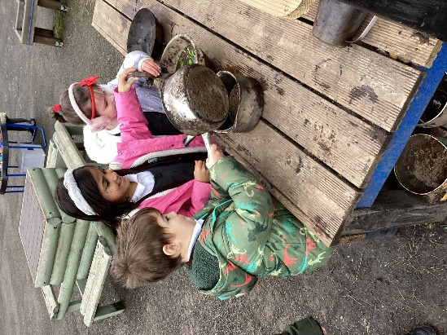
The School Day
School day from 8:30am – 3pm
Soft start from 8:30- 8:45 (Funky Fingers)
Prompt start at 8:45am
Children enter from front playground, which is situated at the front of school
Children will get picked up outside classroom in the Reception playground
Our aim is to provide a rich, varied, and inclusive curriculum which harnesses every child’s potential.

Slide 11
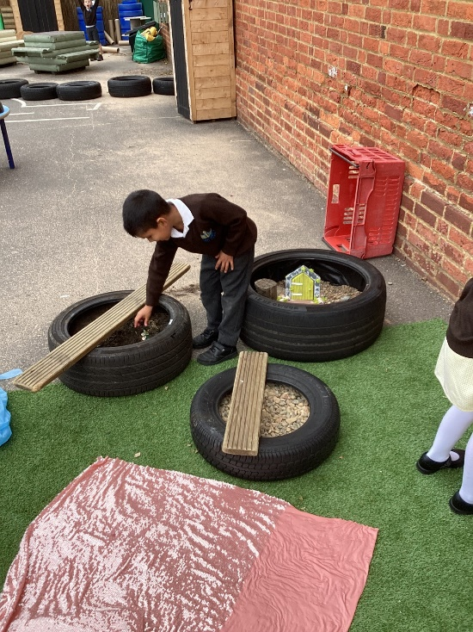
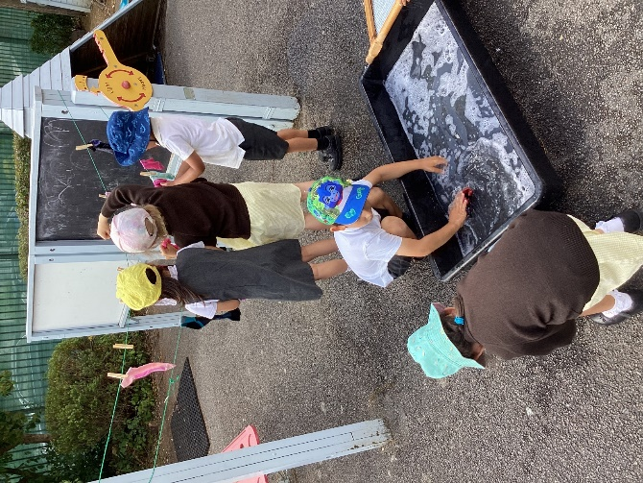
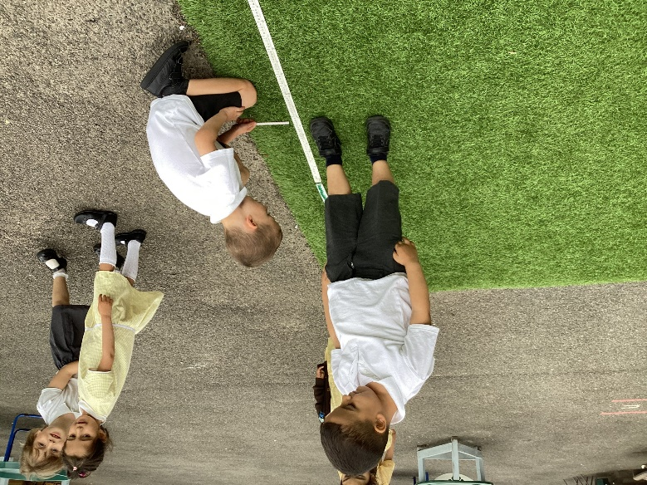
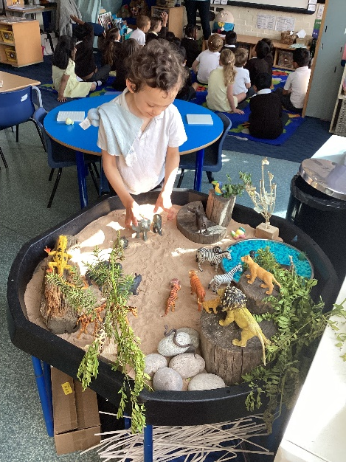
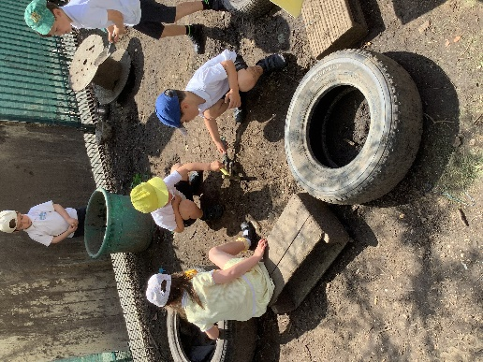
Photos
Our aim is to provide a rich, varied, and inclusive curriculum which harnesses every child’s potential.

Slide 12

Phonics
Little Wandle Programme
teaches children to read, using the skill of decoding and blending sounds together to form words
Daily lessons for the whole class and keep up sessions take place where needed to support all children with the pace of the progressions
We will arrange a parents meeting for the beginning of September to discuss phonics and reading in more detail.
Our aim is to provide a rich, varied, and inclusive curriculum which harnesses every child’s potential.

Slide 13
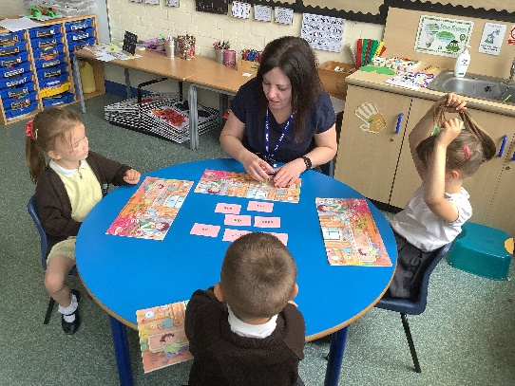
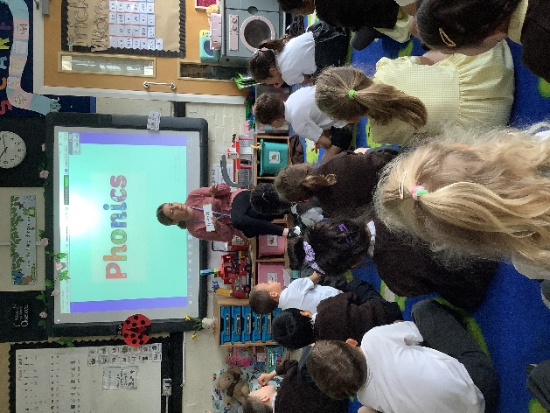
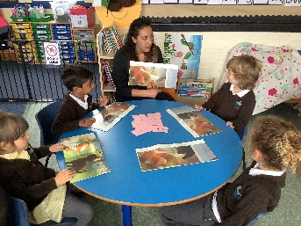
In Reception, children will receive two books a week. ONE decodable book and ONE reading for pleasure book (chosen themselves)
Guided reading sessions - There will be 3 guided reading sessions per week.
Reading
Our aim is to provide a rich, varied, and inclusive curriculum which harnesses every child’s potential.

Slide 14
Guided Reading Session
Our aim is to provide a rich, varied, and inclusive curriculum which harnesses every child’s potential.

Slide 15
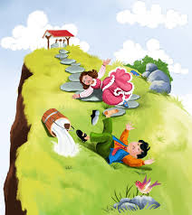


You will be given the details of our first topic for Reception. Please enjoy some of the suggested activities with your child at home. This will help them start Reception with confidence.
Topics
Our aim is to provide a rich, varied, and inclusive curriculum which harnesses every child’s potential.

Slide 16
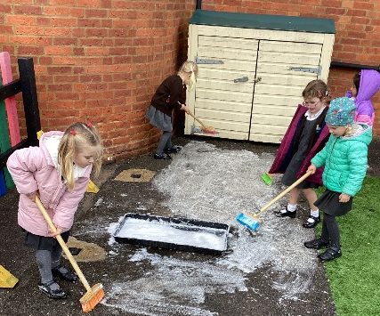
Expectations
On time for an 8:30am start (Registers close at 8:40am)
Correct uniform
Water play and messy play both indoors and outdoors are expectations for EYFS provision – sensory, curiosity and exploration
Spare clothes borrowed from school are returned
Supporting learning at home
Our aim is to provide a rich, varied, and inclusive curriculum which harnesses every child’s potential.

Slide 17
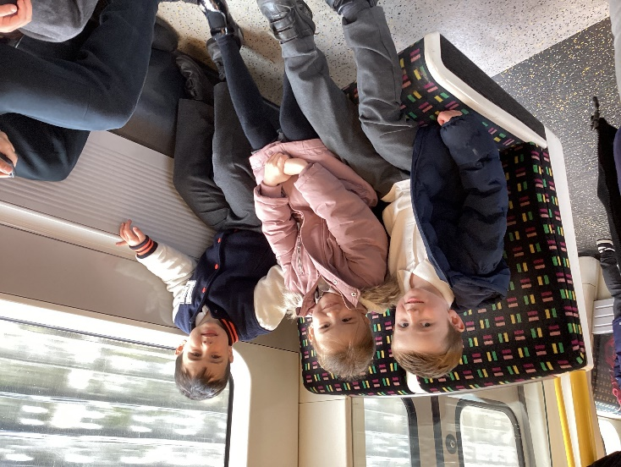

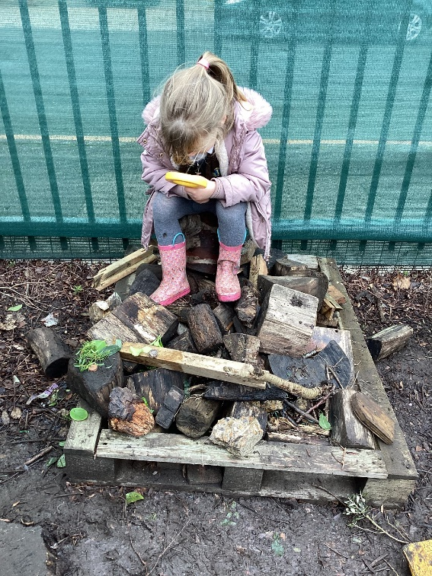
Photos
Our aim is to provide a rich, varied, and inclusive curriculum which harnesses every child’s potential.

Slide 18

Key Dates
Wednesday 4th Stay and play (2 sessions)
9:00am-10:15am or 1:30pm – 2:45pm
Thursday 5th 2 sessions
Session 1 – 9:00am-11:15am
Session 2 – 12:30pm-2:45pm
Collect children from front playground
Friday 6th – All children stay till 1:00pm.
Our aim is to provide a rich, varied, and inclusive curriculum which harnesses every child’s potential.

Slide 19
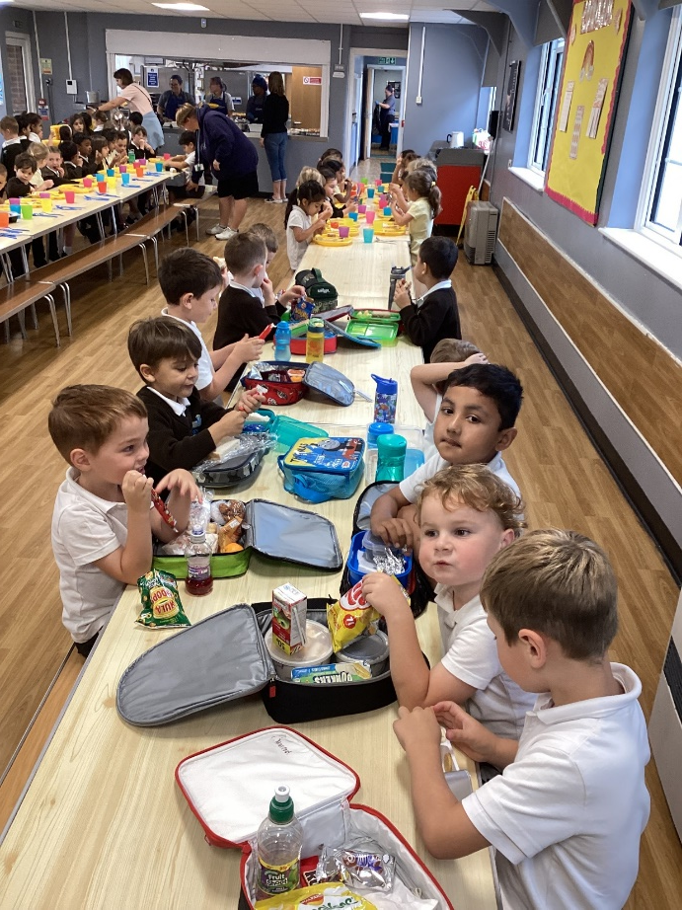
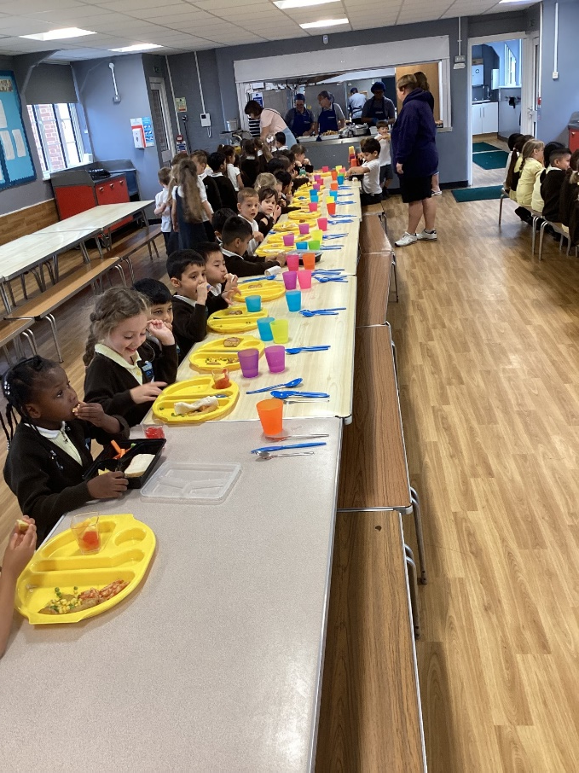
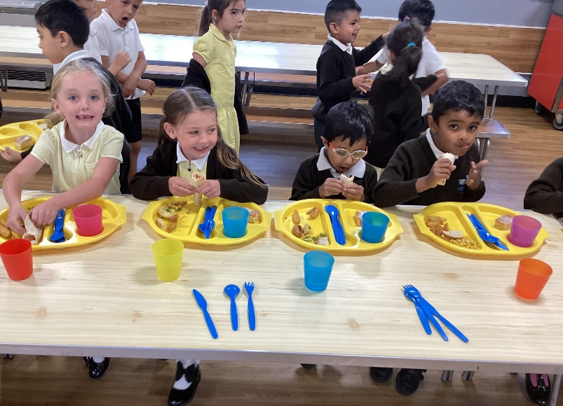
Canteen
Our aim is to provide a rich, varied, and inclusive curriculum which harnesses every child’s potential.

Slide 20

Important Information
Universal Free meals - available to all children in EYFS and KS1 (link is on website)
Uniforms can be bought from Adams Schoolwear in Ruislip Manor
Count Me In – funding is available for some families. If you think you qualify please check the school website and contact the school
FOLBA (Friends of Lady Bankes Association) – if you would like to become involved please contact the school
Our aim is to provide a rich, varied, and inclusive curriculum which harnesses every child’s potential.

Slide 21
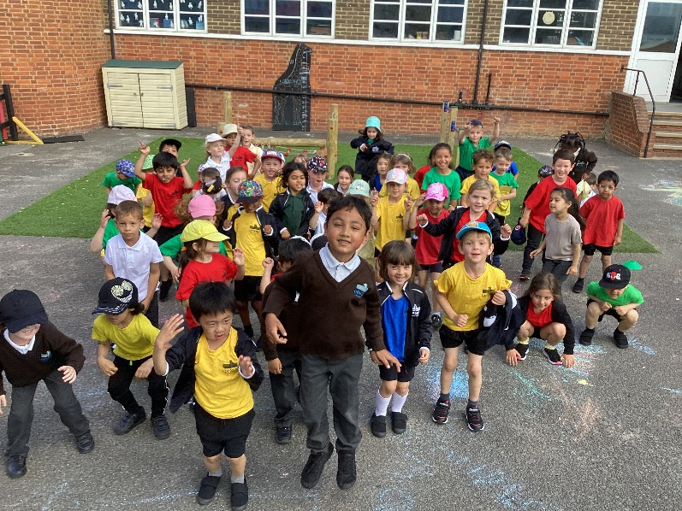
We look forward to seeing you in September.
If you have any questions, queries or concern, please contact us.
Our aim is to provide a rich, varied, and inclusive curriculum which harnesses every child’s potential.

