Slide 1

Welcome to Reception-
A guide for parents
Wednesday 20th September 2023

Slide 2
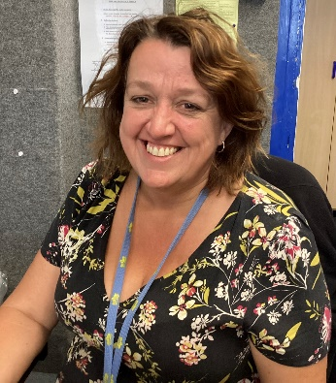
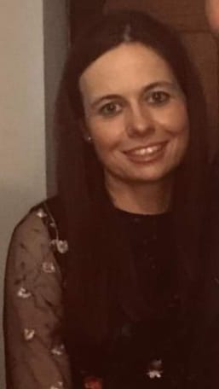
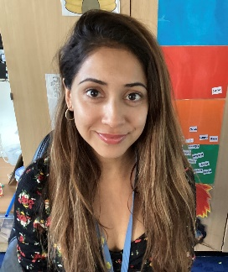
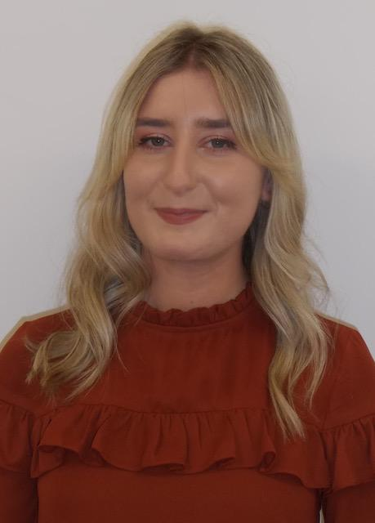
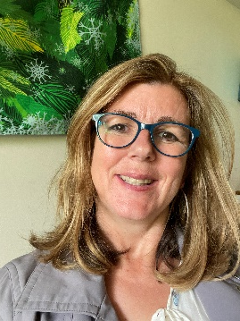
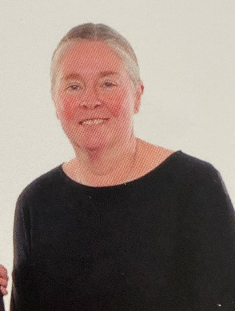
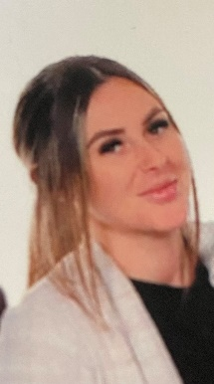
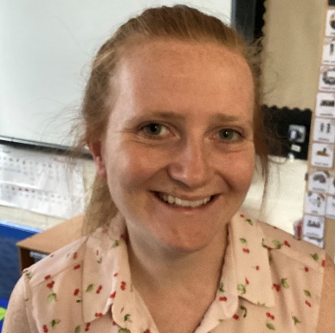
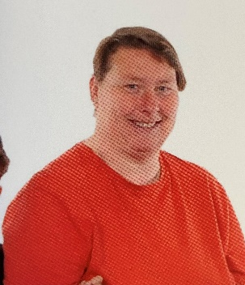
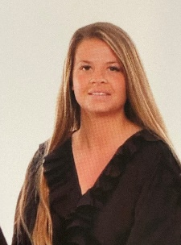
Meet the Team
Mrs McCarthy
Assistant Head of Early Years
Miss Pearce
Year Group Lead
RDP
Mrs O’Sullivan
Mrs Roy
Miss Hawkins
ROR
RLH
Mrs McGlynn
Miss Hone
Mrs Widdows
Mrs Hanson
Miss Wright

Slide 3

The Early Learning Goals
Communication
Personal, social and
Physical Development
Literacy
and
Language
emotional
Expressive arts and design
Understanding the world
Mathematics

Slide 4

Achieving the Early Learning Goal
Communication and Language
Listening, Attention and understanding
Speaking
Personal Social and Emotional Development
Self Regulation
Managing Self
Building Relationships
Physical Development
Gross motor skills
Fine Motor skills
Literacy
Comprehension
Word Reading
Writing
Maths
Number
Number patterns
Understanding the world
Past and Present
People, Culture and Communities
The Natural World
Expressive Arts and Design
Creating with materials
Being imaginative and expressive

Slide 5

How we cover the curriculum?
Monday – Literacy focus
Tuesday – Literacy focus
Wednesday – Maths focus
Thursday – Maths focus
Friday – PSHE Focus
Afternoon sessions – Topic focus

Slide 6

Phonics – Little Wandle
Phonics is taught daily
4 sounds introduced weekly, with a review at the end of the week
Read the same book 3 times a week with a different focus each day
These books will be sent home on Friday with Reading Record book
When you hear your child read please sign their reading record and return it to school on the following Tuesday

Slide 7

Homework
This year there will be regular tasks for you to do at home with your child. These will be uploaded on Google Classroom on a weekly basis
You will be able to upload the homework on Google classroom or bring it in to school
Please hear your child read regularly – reading books will go home on Friday, along with a library book
Help your child learn their tricky words
Please keep practising the correct letter formation

Slide 8

In General
We send out ‘WOW certificates’ every term for you to fill in any achievements your child has made at home or out of school. The first ones will be given around the time of the first parent conference (October)
We will not be doing formal P.E until the summer term so we will let you know when you need to buy a P.E kit. In the mean time please ensure that your child has named appropriate clothing in school that is suitable for every weather!
During the day we have a fruit snack – you may provide this for your child but please ensure that it is fruit.

Slide 9
What can I do at home?
Read with my child on a regular basis
Practise fine motor and gross motor skills
Practise reading tricky words
Play with them –asking questions and having conversations
Helping them to become independent eg getting dressed by themselves

Slide 10


